Slide 1

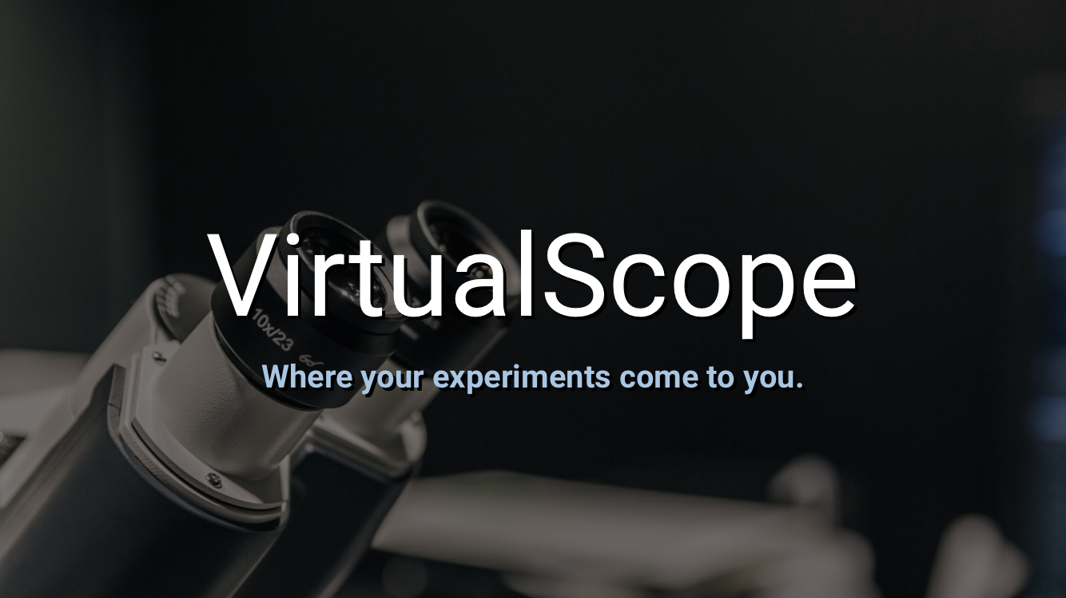




Team: The Majestic Magicians Members: Kevin Day, Kyle Hobbs, Brandon Johnson, Gabriel Otten, Austin Weigel Previous Team: Hlee Yang, Jahia Vang, Ryan Vagle, Yer Moua
With Professor Cindy Harley

Slide 2
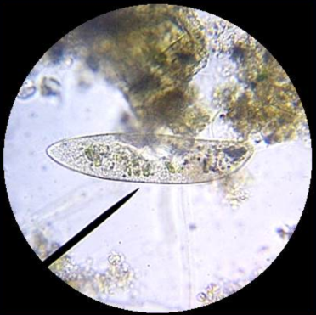
Vision
Limited lab access
Easy to use
Proof of concept

Slide 3

Vision - Features and Capabilities
Team Puma
Live Stream
Time capture screens

Slide 4

Vison – Features and Capabilities
Majestic Magicians
Functional sign-in system
Adjust magnification remotely
Remote Controllable light

Slide 5
VirtualScope 2.0 Use Cases
Previous Version | Version 2.0
3 Actors 2 Primary 1 Secondary 10 Use Cases | 3 Actors 2 Primary 1 Secondary 15 Use Cases

Slide 6

Actors and Their Values
Actors | Values
Student | Speed
 | Ease of Use
 | Availability
 | Accuracy
Administrator | Security
 | Ease of Use
 | Availability
System Authentication | Speed
 | Security

Slide 7
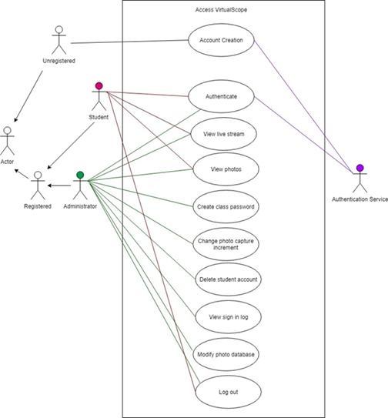
VirtualScope Original Use Case Diagram

Slide 8
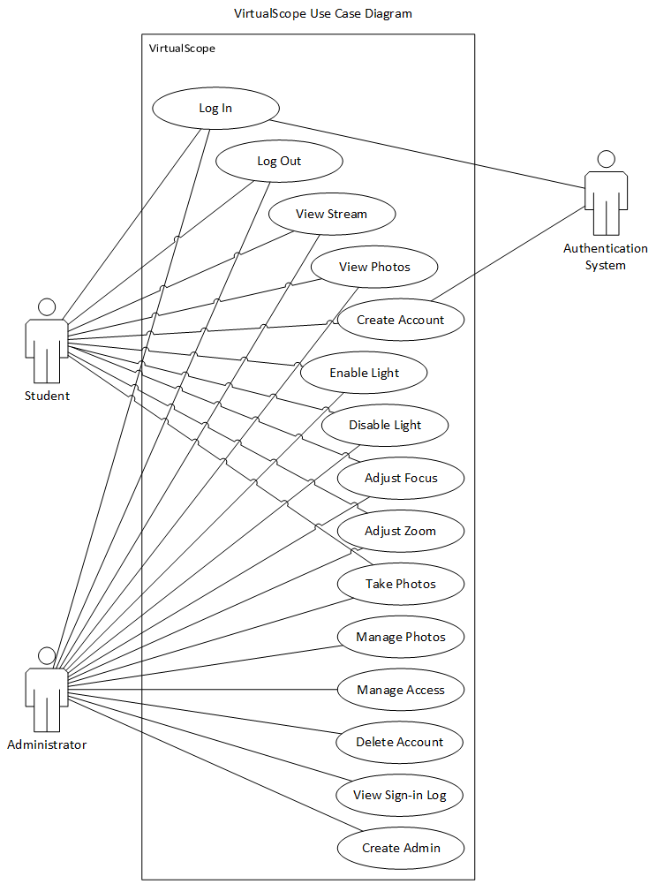
VirtualScope 2.0 Use Case Diagram
Additional Hardware
Light
Adjustment Motors
Additional Hardware Use Cases
Light On/Off
Focus Adjust
Zoom Adjust

Slide 9

User Interfaces
Updated Interface
Microscope stream & control page
Zoom level
Light on/off
New Interface
Administrator page
Who is logged in
Access student database
Disable account
Password reset
Access photos

Slide 10
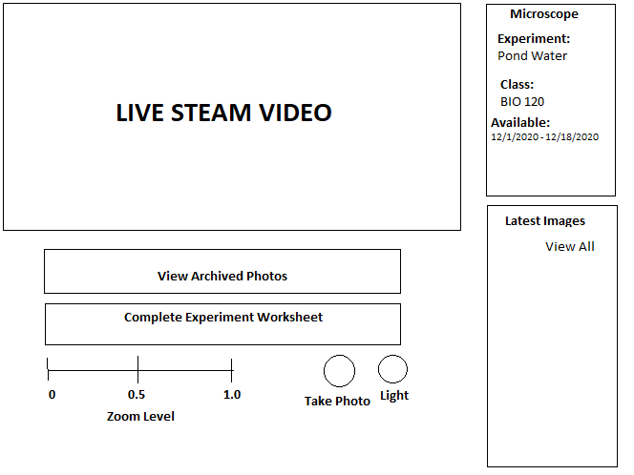
Microscope UI
Live Stream
New features:
Zoom level
Light on/off
Take Photo

Slide 11
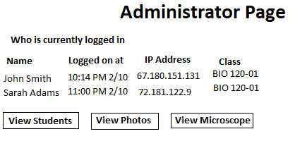
Administrator Page
Features:
Who is currently logged in
View Student
View Photos
View Microscope

Slide 12
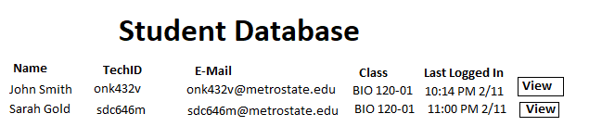
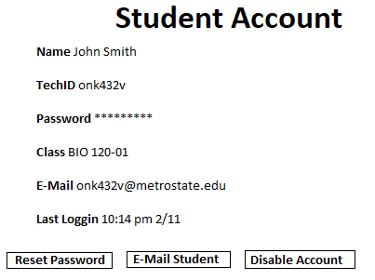
Student Database

Slide 13
Non-Function Requirements
Usability, Maintainability, and Interoperability
Automated installation and easy maintenance dashboard
Well documented instructions and troubleshooting guide
Website should be portable
Notes:
Usability, Maintainability, and Interoperability
Automated installation and easy maintenance dashboard
Well documented instructions and troubleshooting guide
Website should be portable
Portable – The web server should be able to run off most Unix-based systems.
Raspberry Pi Web Server, all in one system
Dedicated Web Server option available

Slide 14
Non-Function Requirements
Reliability and Scalability
All Systems should be Stable and able to run ~24/7
Pi Systems Should Prioritize Uptime during Experiments
Multiple Permission Groups should exist
Notes:
Uptime during Experiments – Pi Systems should not update/patch/crash during experiments.
Permission Groups – Classes, Admins, etc.
Multiple Permission Groups should exist
Students
Classes with designated professor(s)
Security Administrators
Etc.

Slide 15
Non-Function Requirements
Security
Hardened against common threats
Automatic Updates
Users should be authenticated via StarID (LDAP) or Email Verification
Notes:
LDAP – This optional feature would allow students to login using their StarID. By implementing this feature it would make it extremely vital that this codebase is secure and LDAP is implemented securely.
There should be an update functionality for the Pi. Automatic would be a button that an administrator could push to update, it would not be a “Windows 10” style update system.
Security
Hardened against common threats
Automatic Updates
Raspbian Operating System
Website and Backend Services
Users should be authenticated via LDAP or Email Verification
Professor verification based on email (@metrostate.edu)
Student verification based on email (@my.metrostate.edu)
LDAP Authentication (Minnstate StarID)

Slide 16
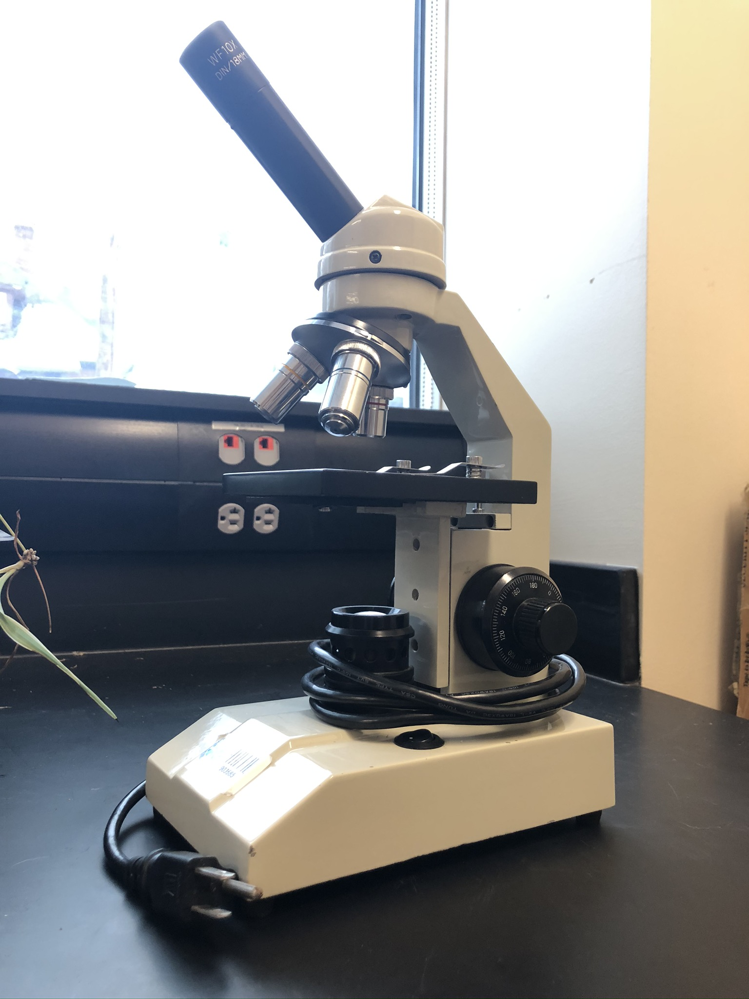
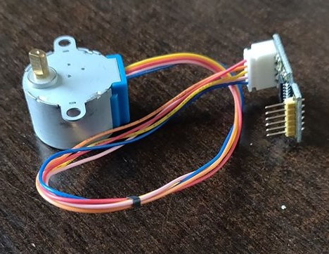
Technical challenges
Controlling microscope focus
Acquiring VPN access – Students not normally allowed access
Lag – Set specific increments for focusing microscope
Privileges – Do not allow simultaneous control
Controlling lights with Raspberry Pi
Preventing damage

Slide 17
Technical Challenges
MotorMovingExample.mp4

Slide 18
Non-technical challenges
Mounting stepper motors to the microscope
Documenting completed work for future teams to understand
Funding for supplies such as stepper motors, mounts, etc.

Slide 19
Any Questions?

